Slide 1
M. Tech CSE – Second Semester (Term: July-October 2022) 20 Marks component- Seminar on Generalized Measurements in Quantum Mechanics
Ramaiah Institute of Technology
(Autonomous Institute, Affiliated to VTU)
Department of Computer Science and Engineering
Presented By: Sai S Joshi
Usn : 1MS21SCS18
Course: Quantum Computing
Course code: MCS22
Course faculty: Dr. S Rajarajeswari

Slide 2
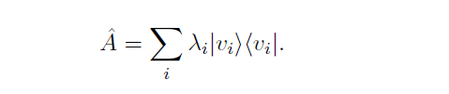
Introduction to Generalized measurements
Measurements are what links the world of quantum mechanics to the classical world. Through measurements, we extract information about quantum systems.
A standard way to describe quantum measurements is as a projection in the Eigen basis of some observable. If an observable is described by the Hermitian operator A, then we can express it using its eigenvalues i and eigenvectors as –

Slide 3
Introduction to Generalized measurements
Projective quantum measurements are too restrictive. They cannot conveniently describe all measurements that can be realized in actual experiments.
More general measurements, so-called probability operator measures (POMs) or positive operator- values measures (POVMs). These generalized quantum measurements can describe any measurement that is possible within the framework of quantum mechanics.
It is impossible to predict the outcome of a quantum measurement. We can only predict its likelihood.

Slide 4
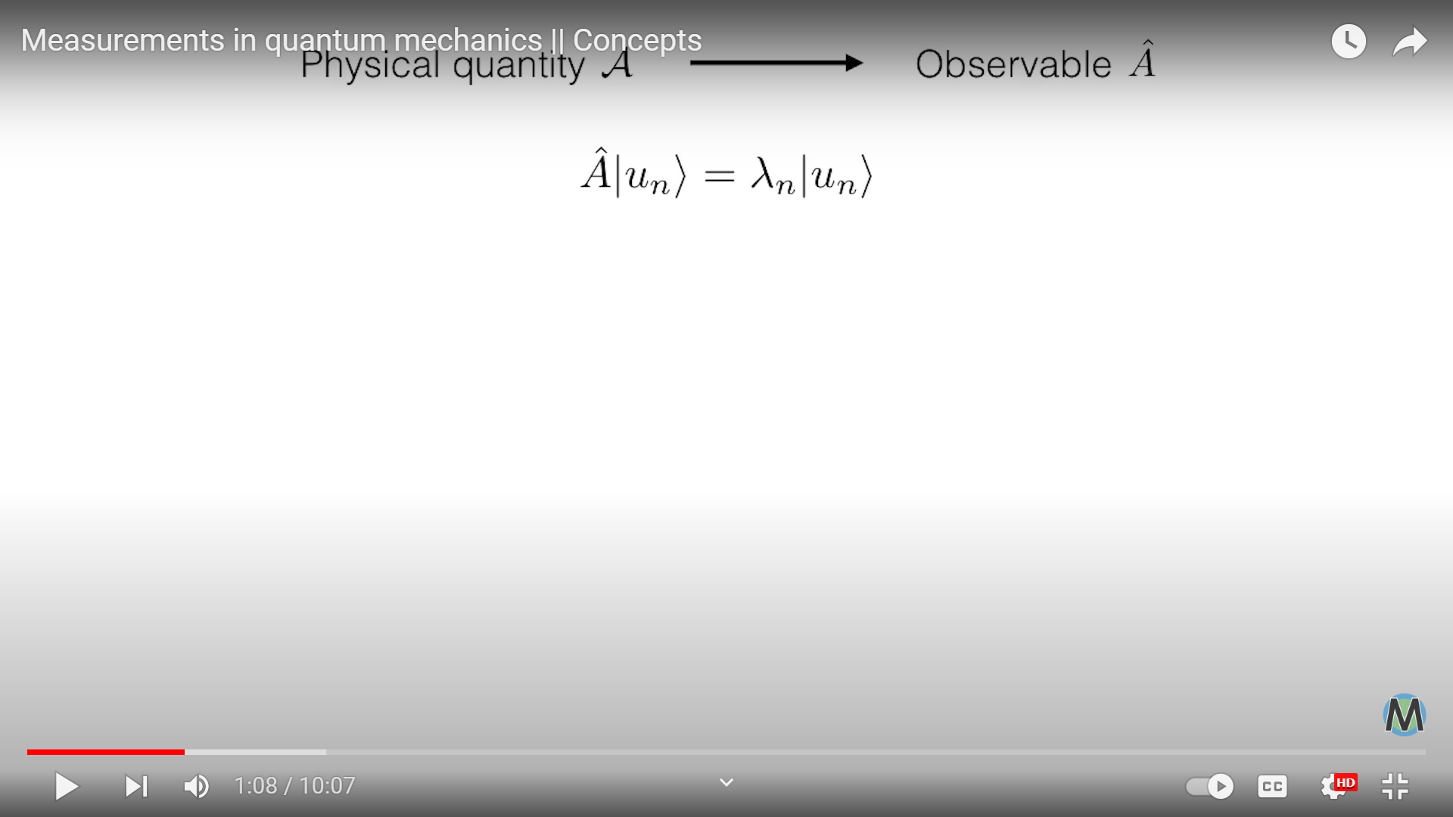
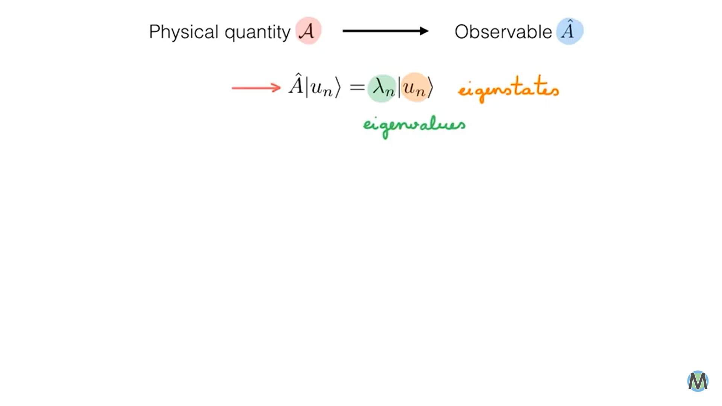
Using Generalized measurements
The physical quantity to be measured could be the position of a particle, its momentum or its energy. From Postulate 2, we know that such a quantity is associated with a Hermitian operator, called an Observable.
Eigenvalue equation :

Slide 5
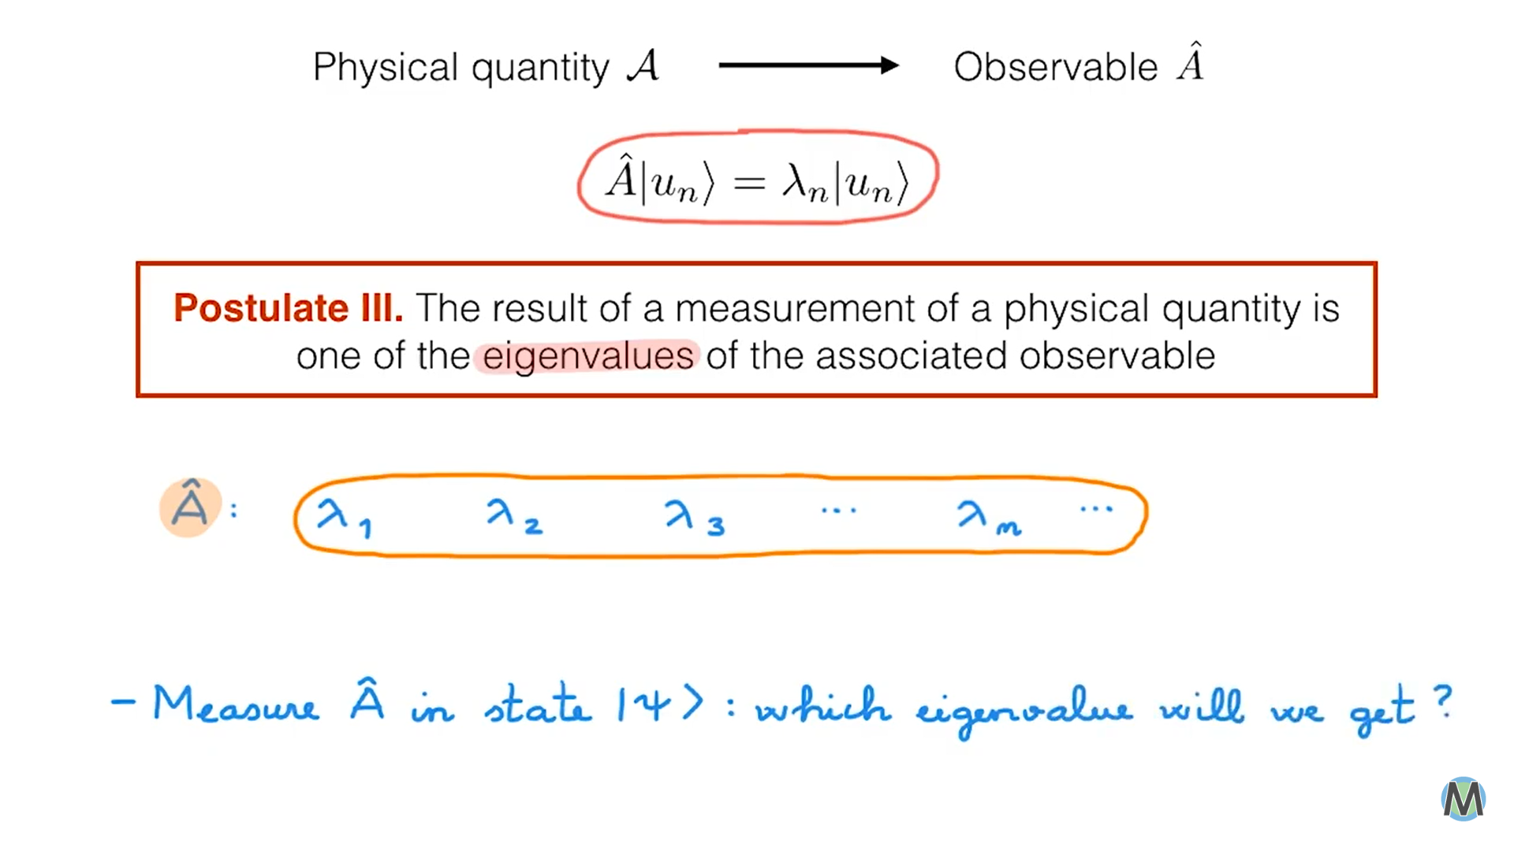
Eigenvalue equation
To measure operator A, we first need to solve the eigenvalue equation, which allows to find the eigenvalues.
Postulate 3 tells us – whatever state our system is in when we measure A, only one of these eigenvalues will be the outcome of the measurement.
Operator A encodes all the possible outcomes of the measurement irrespective of the state of the system.

Slide 6
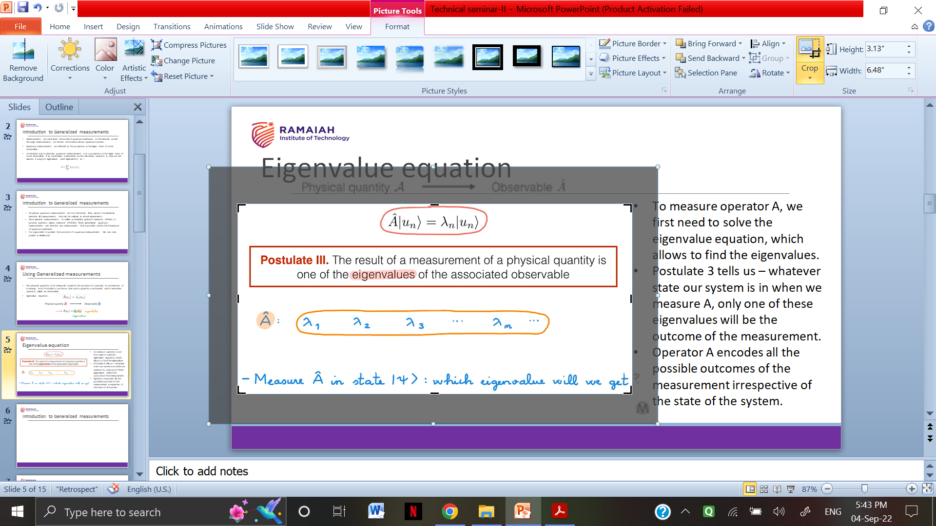
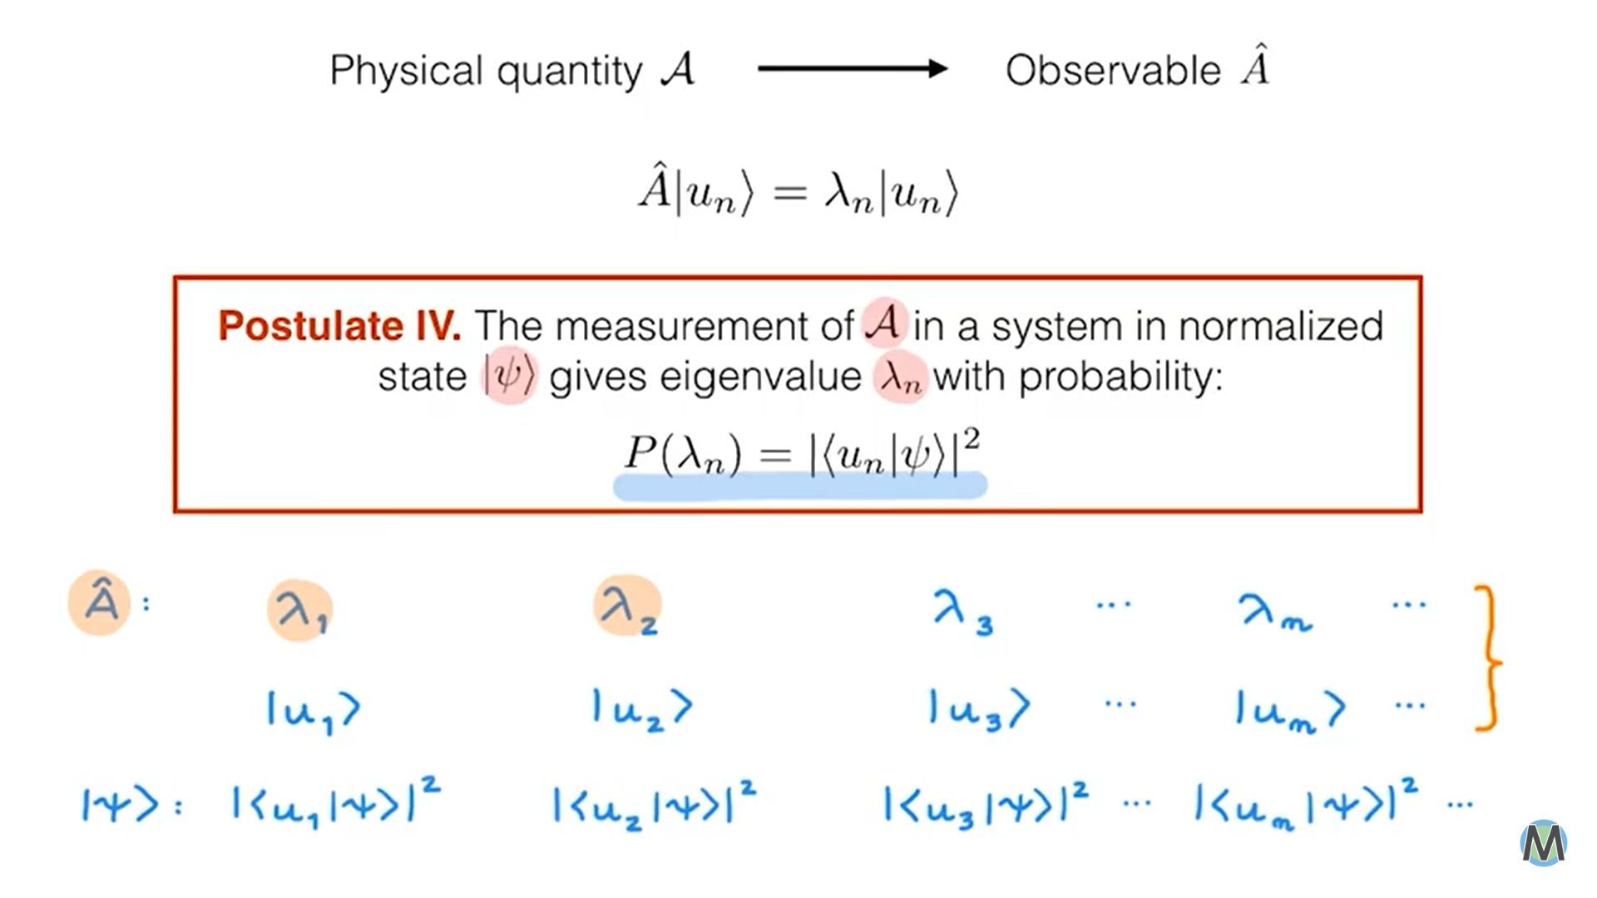
Measuring A in a specific state

Slide 7
Measuring A in a specific state
For operator A, there is a list of lambda values and each of these values corresponds to an Eigen state . These two lists are always the same for A and are independent of the state of our system.
When we measure A in a specific state |ψ> , Postulate 4 tells us the following –
- We will get λ 1 with the probability given by the absolute value squared of u1|ψ>
- λ 2 with the probability given by the absolute value squared of u2|ψ>… and so on.

Slide 8
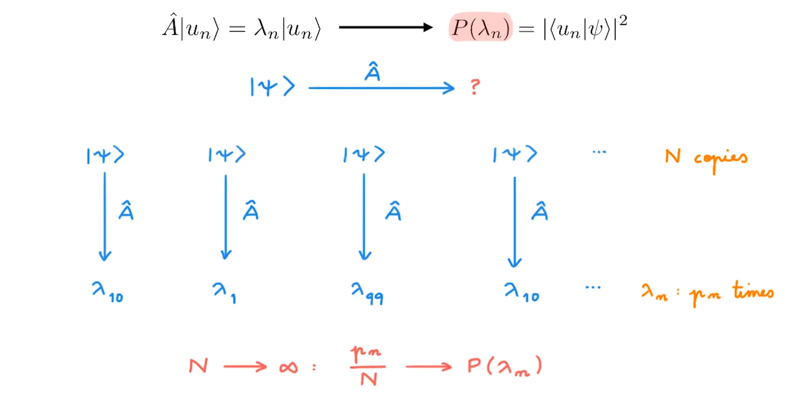
Measuring A in copies of the state

Slide 9
Measuring A in copies of the state
If rather than having one system in state ψ, we have exact copies of the system in state ψ, when we measure A for each of these systems, we can in principle, get any of the possible eigenvalues as an outcome.
When the number of copies of the system becomes very large, the fraction of measurements that give λn, which is Pn over n , approaches the probability P (λn).- which is the exact rate at which we will get a particular outcome when we have an infinite number of copies of the same exact system.

Slide 10
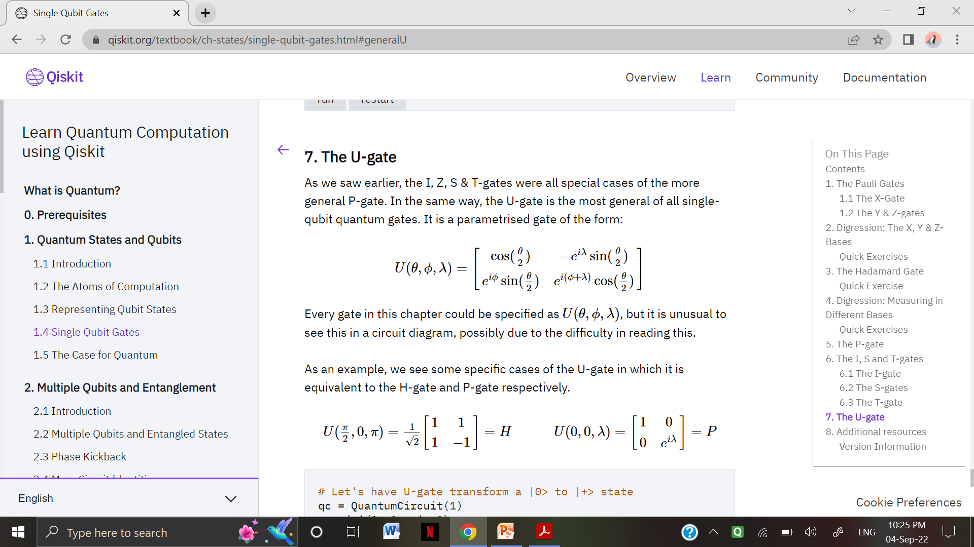
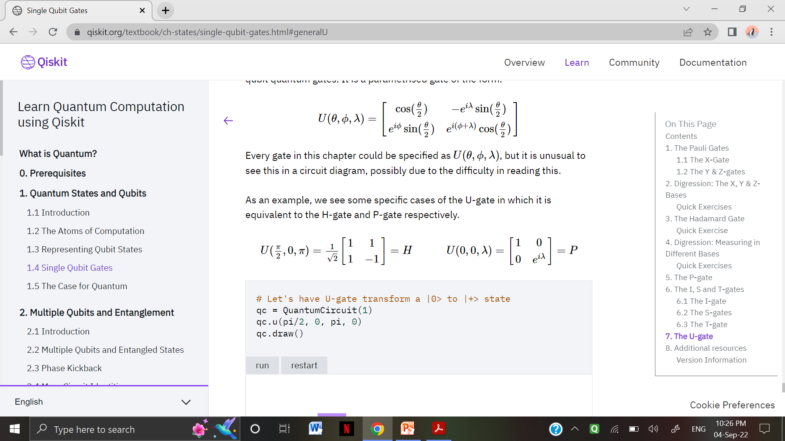
Qiskit – U Gate
the U-gate is the most general of all single-qubit quantum gates. It is a parameterized gate of the form:
As an example, we see some specific cases of the U-gate in which it is equivalent to the H-gate and P-gate respectively.
P gate : diagonal phase gate, H gate : Single qubit hadamard gate

Slide 11
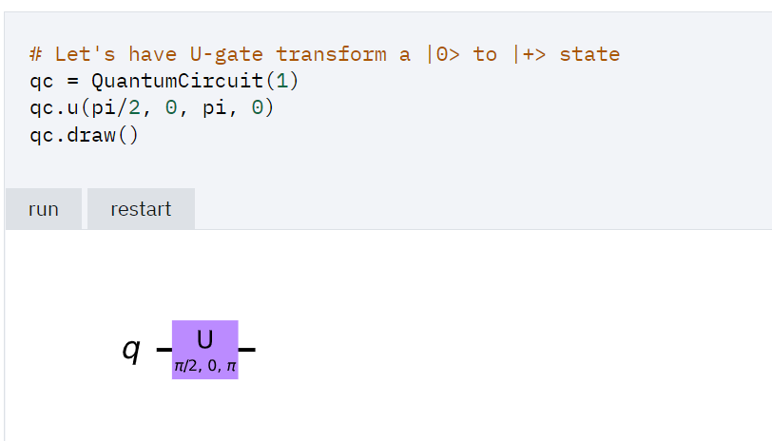
Qiskit – U Gate

Slide 12
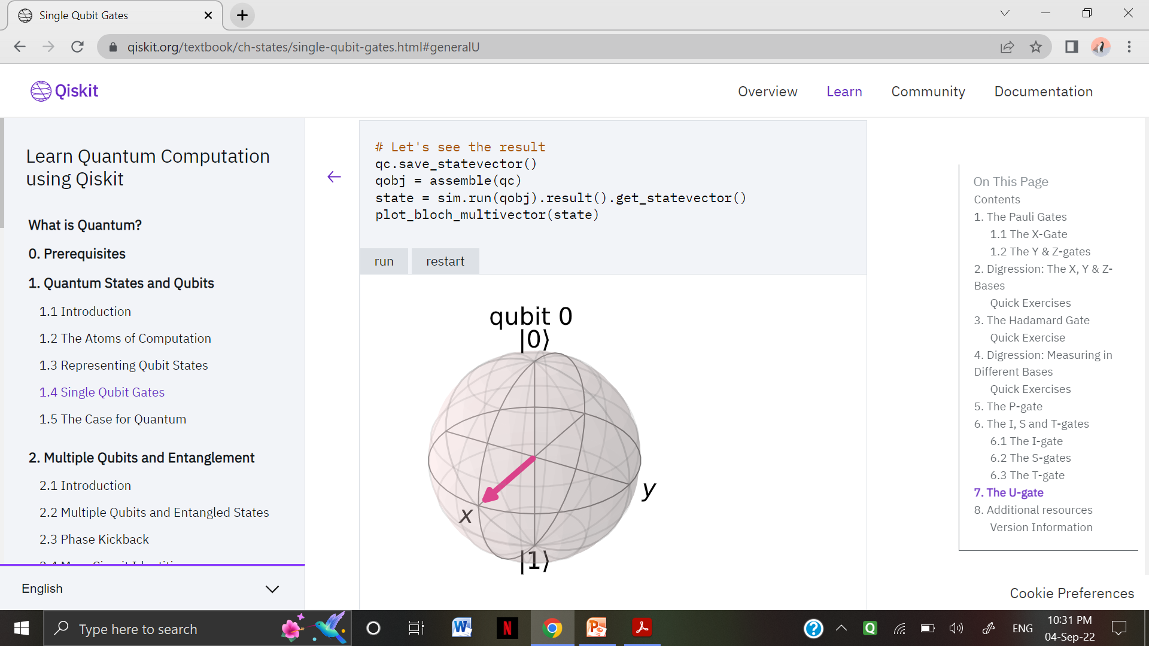
Qiskit – U Gate

Slide 13
References
[1] QUANTUM MEASUREMENTS - Lecture notes for WAQCT Summer School 21-26 August 2019
Erika Andersson, Heriot-Watt University, Edinburgh, UK
[2] Generalized Quantum Measurement - Nicholas Wheeler , September 2012
[3] Measurements in Quantum mechanics- concepts
https://youtu.be/u1R3kRWh1ek

Slide 14
Thank you.

